Slide 1
Shared Parking Tool User Guide
Python and GIS User Guide
July 2023

Slide 2

RSG ITE and ULI Spatial Parking Demand Tool
Table of Contents
SECTION 2: Installation & Running | 3-6
SECTION 3: Outputs & Post-Processing | 7-14
SECTION 4: Post-Processing Outputs | 15-16

Slide 3
SECTION 1:
INPUTS TO THE GIS PARKING TOOL

Slide 4
SECTION 2:
INSTALLATION & BACKGROUND SOFTWARE

Slide 5

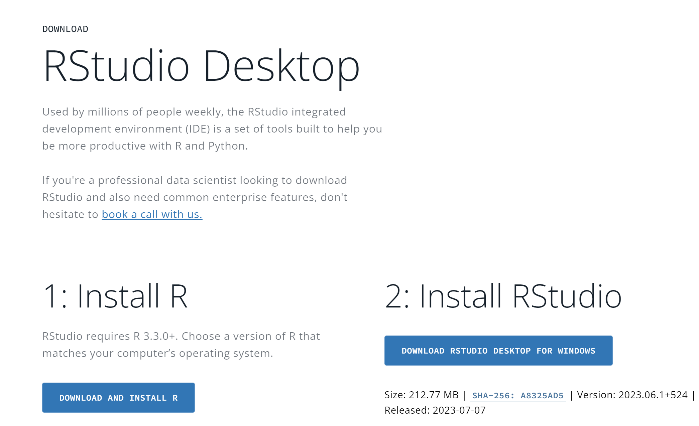
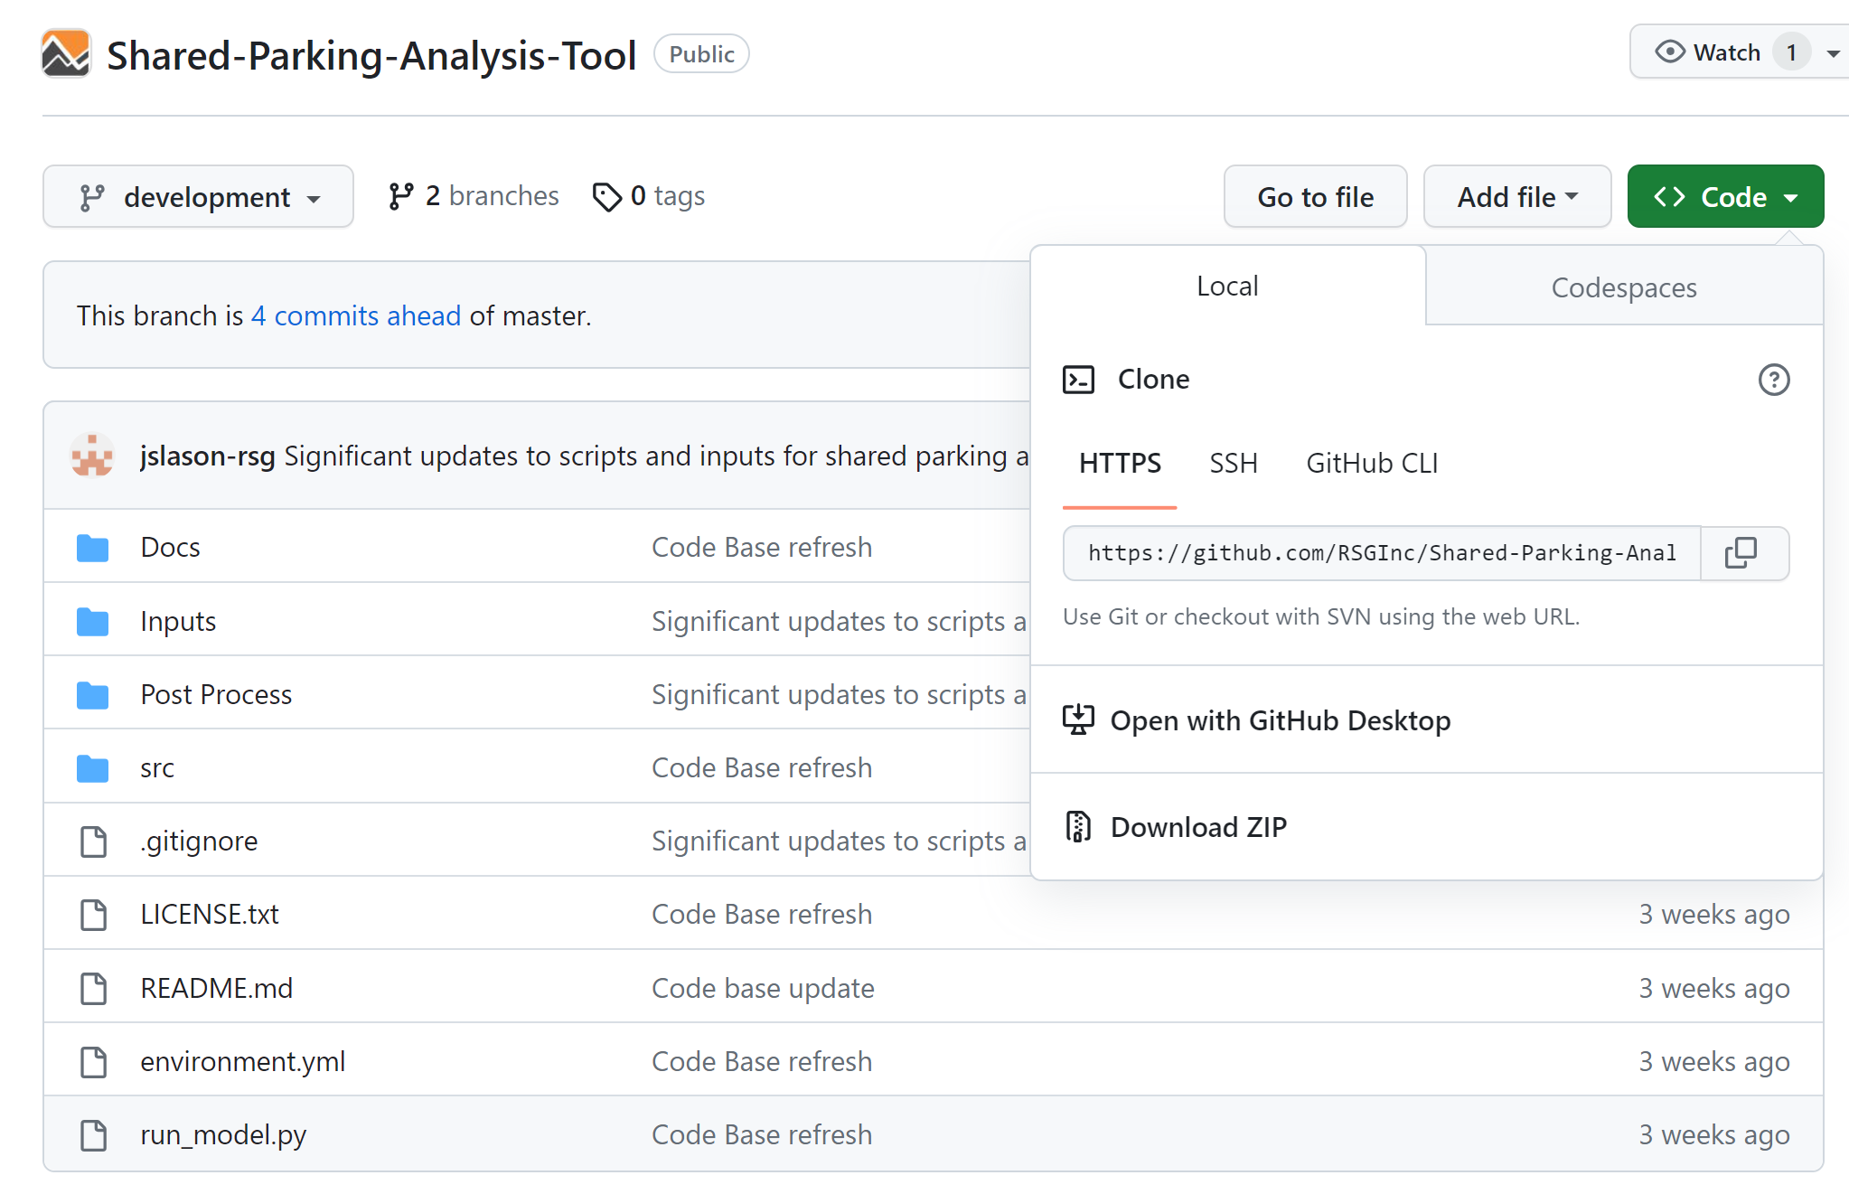
BACKGROUND SOFTWARE
Necessary software to run the tool:
Conda via Anaconda or Miniconda
R and R Studio (https://posit.co/download/rstudio-desktop/)
GIS software (QGIS, ArcGIS, ArcMap)
Download the SPA Code:
Download Zip the repository in root C drive or local Documents location
Download Zip

Slide 6
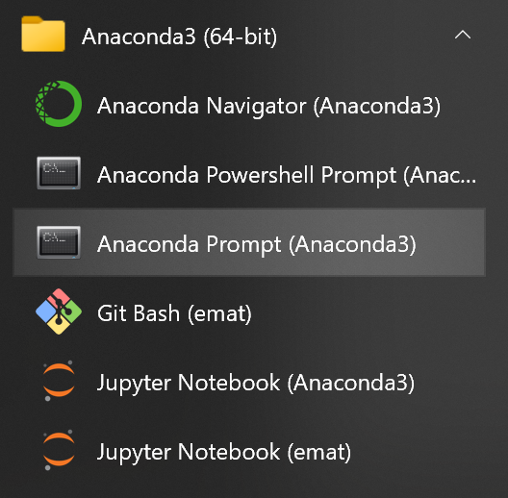
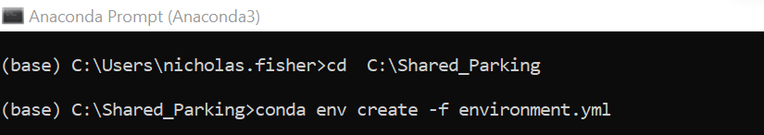
INSTALLING THE TOOL
Use Anaconda prompt to install the SPA Tool:
Open an Anaconda Prompt:
Install the Shared Parking Environment by running the .yml file:

Slide 7
INSTALLING THE TOOL
Use Anaconda prompt to install the SPA Tool:
In the context of Python, an environment is a collection of packages and their dependencies that are used for a specific purpose, such as scientific computing or data analysis.
Separate environments are used for different projects, each with its own set of packages and dependencies, so that you can have different versions of packages installed for different projects without them conflicting with each other.
This can be especially useful when working on projects that have different package requirements or when you want to test your code against different versions of packages. By using separate environments, you can avoid dependency conflicts and ensure that your code will run consistently in different environments.
Open an Anaconda Prompt:
(Start menu→ Andaconda Prompt)
Run the following to install the Conda Environment:
user.name

Slide 8
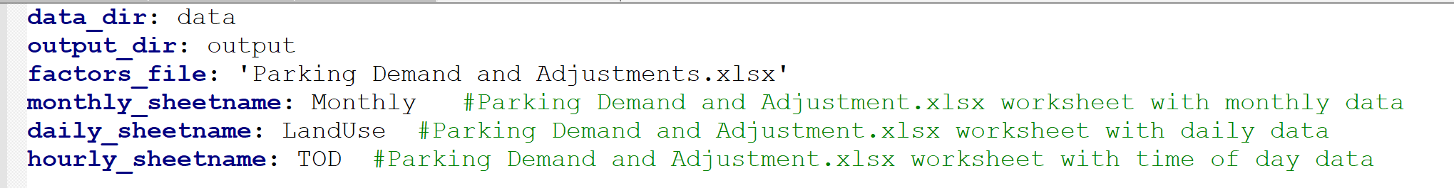
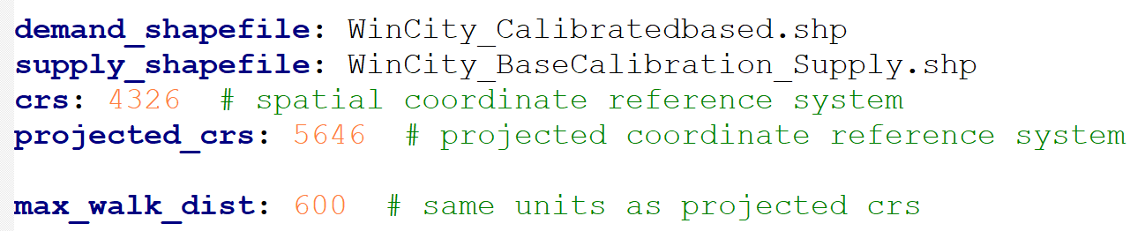
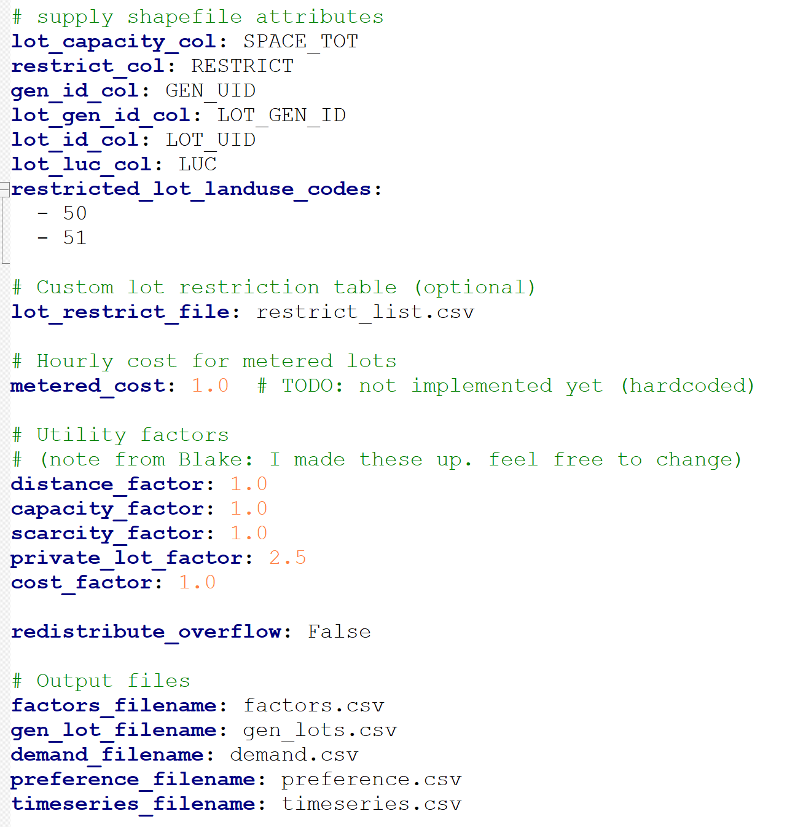
INPUTS TO THE CONFIGURATION FILE
Configuration.yaml
Open the file in a text editor
Most inputs are set to align with the ULI parking data in the “Parking Demand and Adjustments.xlsx” file.
Specify the names of the shapefile for the scenario
Specify the maximum allowed walking distance in the utility and parking equation
The column names in the shapefile
Restricted file name
Utility function costs which are used to calibrate the parking model
Output files from the python script. Don’t change.

Slide 9
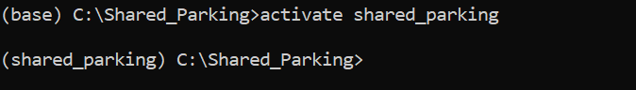
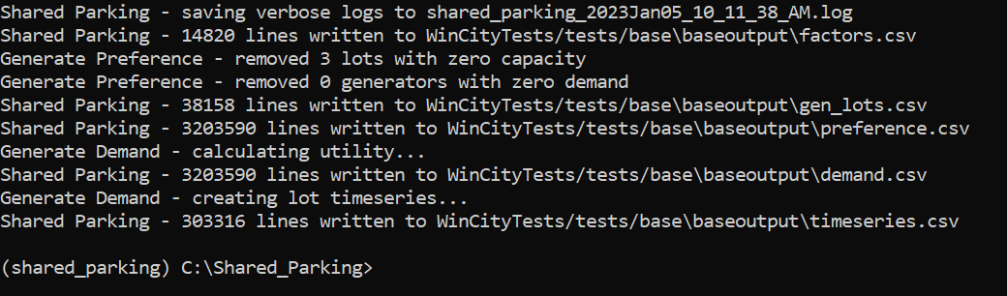
RUNNING THE TOOL
Line points to location of model script and the location of the configuration script.
Note: watch the direction of the “/”
Use the Anaconda prompt to activate the SPA Tool:
Activate the SPA Tool
Run the tool using “cnfg.yaml” example configuration:
The following output should be produced:

Slide 10
SECTION 3:
OUTPUTS & POST-PROCESSING

Slide 11
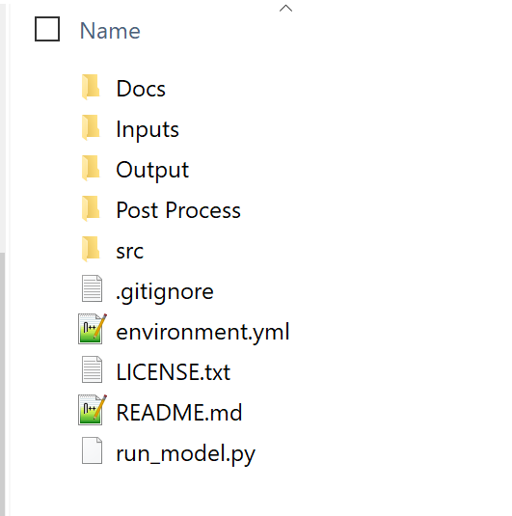
OUTPUT DATA
Running the Python script will produce this Output folder →
CSV outputs for post-processing:
The python shared parking analysis script produces the following output CSVs
‘demand.csv’ : Demand for individual lots
‘factors.csv’ : Hourly adjustment factors for individual lots
‘gen_lots.csv’ : Parking generators with generator and lot IDs
‘preference.csv’ : Information for parking preferences
‘timeseries.csv’ : A time series of utilization by lot

Slide 12
SECTION 3:
POST-PROCESSING OUTPUTS

Slide 13
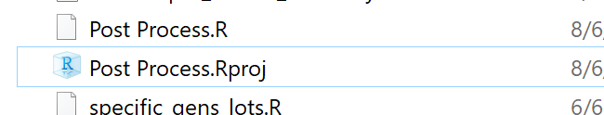
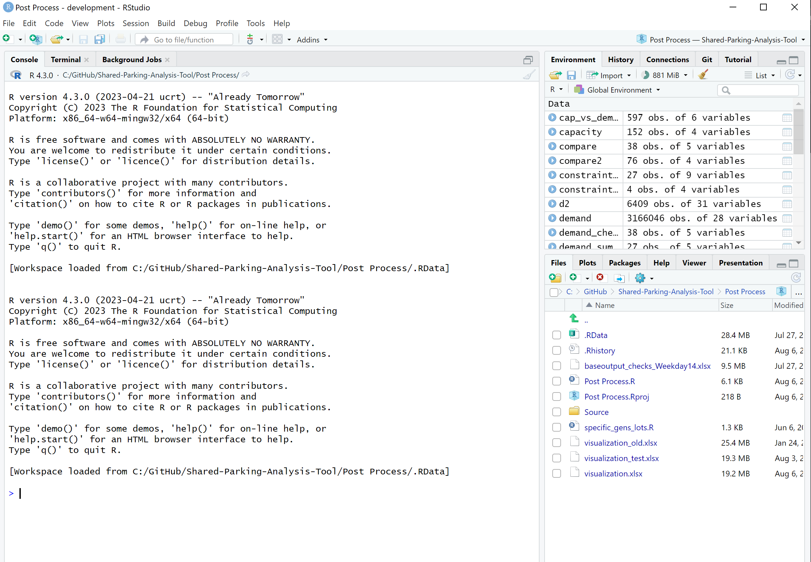

R Studio
Click on
Post Process.Rproj
Open R Studio to use the R software language to analyze the parking model results

Slide 14
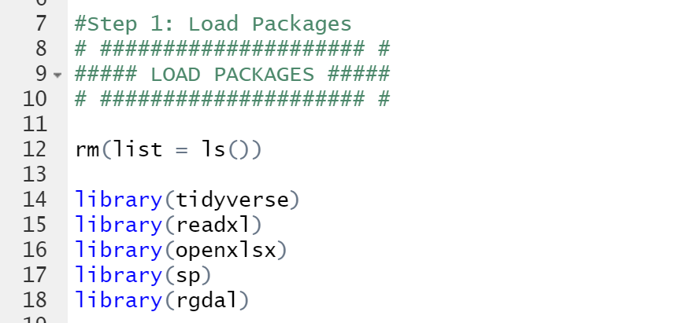
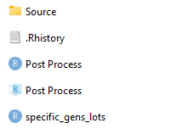
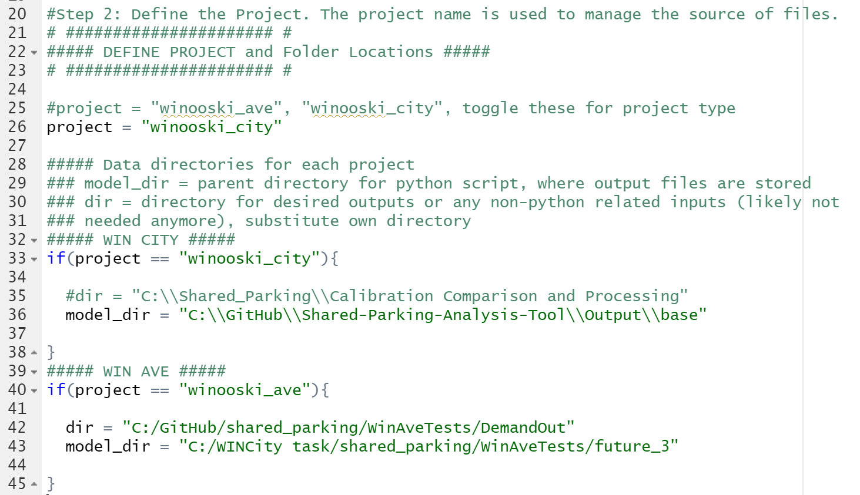
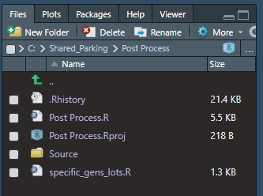
POST-PROCESSING
Install and load required R packages:
Define the project type and output directories
Open ‘Post-Processing’ folder:
Open R project titled ‘Post Process’:
In R Studio, open the ‘Post Process.R’ script:

Slide 15
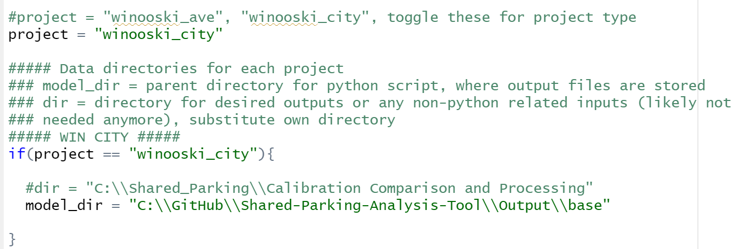
POST-PROCESSING
Set the directories – Example Winooski_City:
The model directory should contain the folder titled “output.” In this example, we are using the project “winooski_city.” :

Slide 16
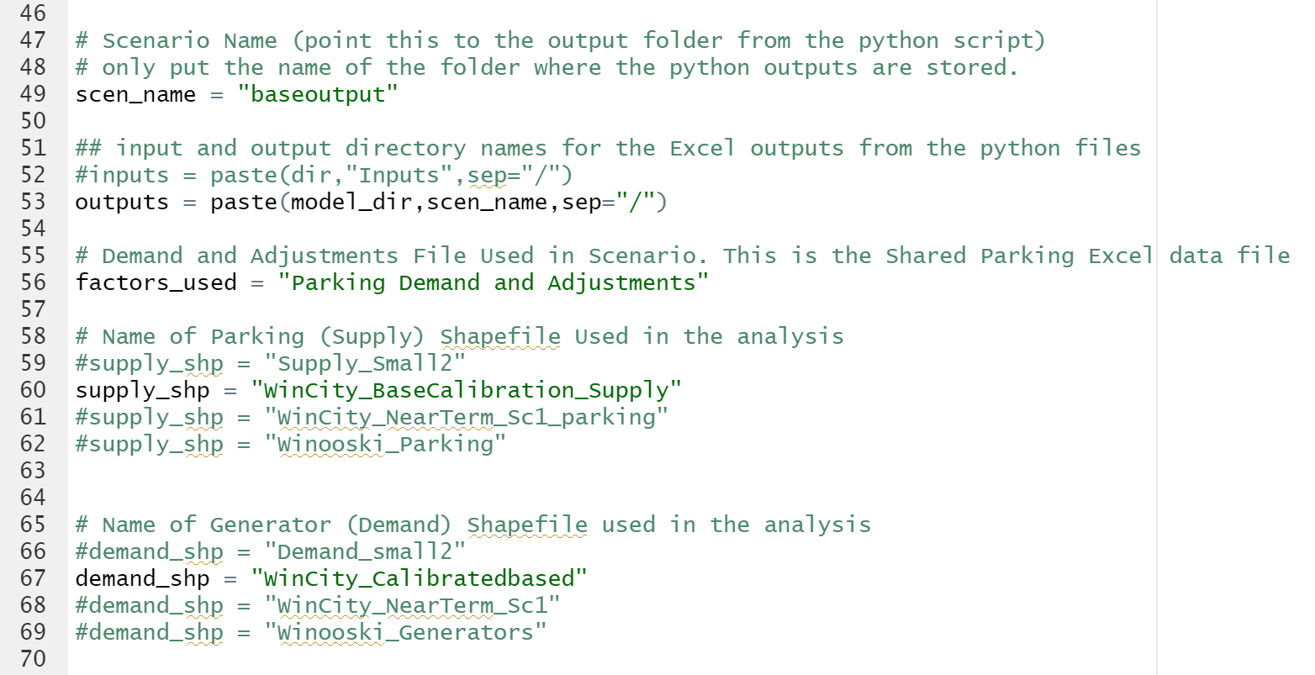
POST-PROCESSING
Set the directories and shapefile – Example Winooski_City:
The model directory should contain the folder titled “output.” In this example, we are using the project “winooski_city.” :

Slide 17
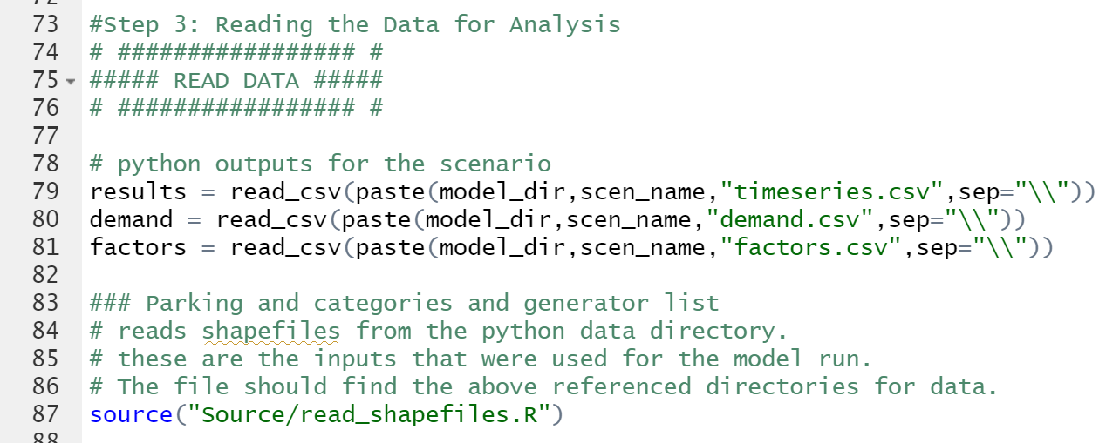
POST-PROCESSING
Read the data:
Read in outputs from the Python model and shapefile inputs used for the SPA model. The folder “Source” containing additional R scripts must be in the same directory as the R project to run these steps:

Slide 18
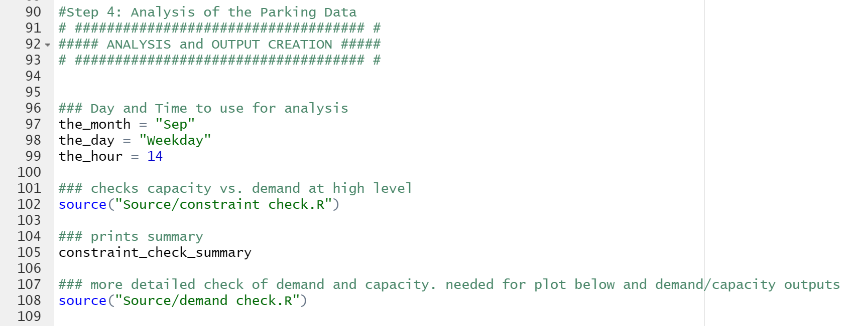
POST-PROCESSING
Define the specific time period for the calibration and validation demand vs capacity checks
Run the constraint check and demand check scripts to project parking capacity versus parking demand:

Slide 19
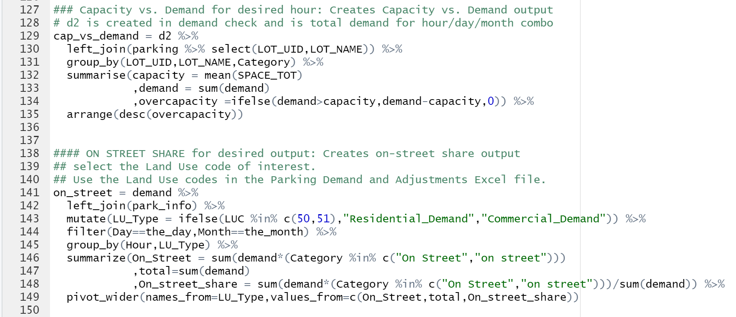
POST-PROCESSING
Perform parking demand analysis:
Develops counts for weekday and weekend demand by hour, day, and month:

Slide 20
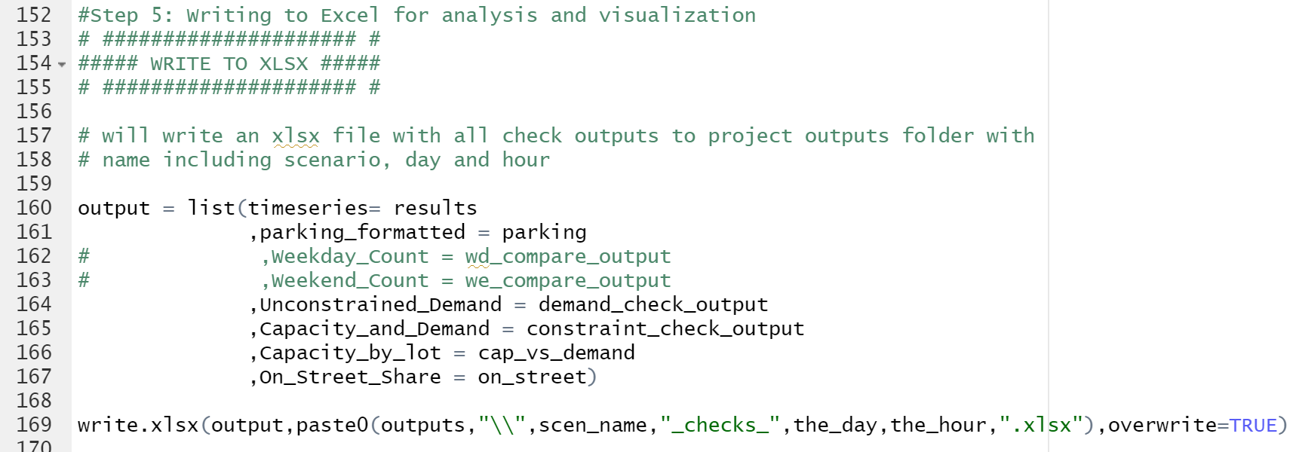
POST-PROCESSING
baseoutput_checks_Weekday14.xlsx
Export output:
The Excel file is designed to help with calibrating the model inputs by focusing on the demand for a specific time period (in this case the 2pm weekday).
Final step will export output as an Excel file:

Slide 21
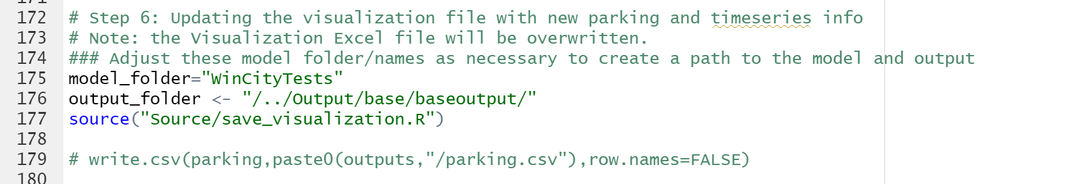
POST-PROCESSING OUTPUT
Post-processing will generate the Excel file ‘visualization.xlsx’ in the model directory:
“Overall summaries” : Contains pivot tables showing high-level summaries of parking by type or street with changeable filters for month, day, hour, and parking type (ex. Residential, on-street, commercial).
“OnStreet 3 period” : Shows on-street percent utilization for parking lots by street name for hours 8, 13, and 18.
“Single Street Pivot” : Shows total parking demand and percent utilization for all lots over a 1-day period on a given street.
“parking_formatted” : Geographic information of parking lots.
“timeseries” : Raw data for parking utilization by street, time, and land use.

Slide 22
Visualization Excel
Using the Visualization Excel Analysis
Visualization Excel file explores all of the python results to allow analysis
By time, street, type of parking, etc.
First step: Refresh all Pivot Tables
“Overall summaries” : Contains pivot tables showing high-level summaries of parking by type or street with changeable filters for month, day, hour, and parking type (ex. Residential, on-street, commercial).
“OnStreet 3 period” : Shows on-street percent utilization for parking lots by street name for hours 8, 13, and 18.
“Single Street Pivot” : Shows total parking demand and percent utilization for all lots over a 1-day period on a given street.
“parking_formatted” : Geographic information of parking lots.
“timeseries” : Raw data for parking utilization by street, time, and land use.

Slide 23

Thank you
NOTE
Jonathan Slason
DIRECTOR
Jonathan.slason@rsginc.com +1 802 698 3196

